Slide 2
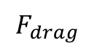
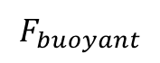
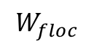
Free Body Diagram
terminal_velocity_FBD.png
$$F_{buoyant}$$
$$F_{drag}$$
$$W_{floc}$$

Slide 3
drag_coeff_Re_base.png
Stokes Law

Slide 4
drag_coeff_Re_full.png
Stokes Law
laminar
turbulent
turbulent boundary

Slide 5
terminal_velocity_floc_diam.png
Floc blanket velocity
AguaClara plate settler capture velocity
Primary particle terminal velocity

Slide 6
horizontal_flow_tank_base.png
W
H
entrance
exit
L

Slide 7
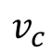
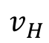
horizontal_flow_tank_capture.png
W
H
$$v_{H}$$
exit
entrance
$$v_{c}$$
L

Slide 8
horizontal_flow_tank_small_capture.png
W
H
$$v_{H}$$
exit
entrance
$$v_{c}$$
L

Slide 9
vertical_flow_tank_base.png
exit
L
W
H
entrance

Slide 10






sed_tank_overview.png

Slide 11
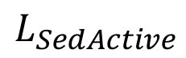
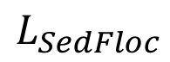
sed_tank_flow_conserve.png
“lost triangle”
$$L_{SedActive}$$
$$L_{SedFloc}$$

Slide 12
H
L
S
B
α

Slide 13
L
H
S
α

Slide 14
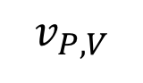
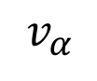
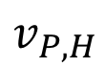
L
H
S
α
$$v_{α}$$
$$v_{P,V}$$
$$v_{P,H}$$

Slide 15
H_{c}
L
H
S
α
$$v_{α}$$
$$v_{P,V}$$
$$v_{P,H}$$

Slide 16
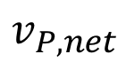
H_{c}
L
H
S
α
g
$$v_{α}$$
$$v_{P,net}$$

Slide 17
Critical path
H_{c}
L
H
S
α
g
$$v_{α}$$
$$v_{P,net}$$

Slide 18
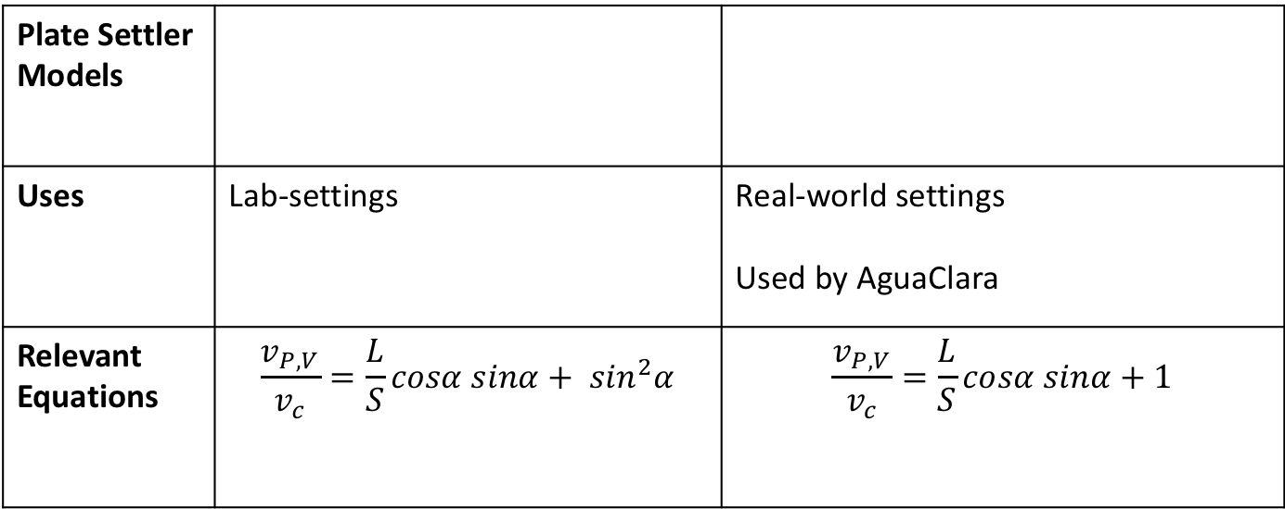
Plate Settler Models
Uses | Lab-settings | Real-world settings Used by AguaClara
Relevant Equations | $$\frac{v_{P,V}}{v_{c}}=\frac{L}{S}cosα sinα+ \sin^{2}α$$ | $$\frac{v_{P,V}}{v_{c}}=\frac{L}{S}cosα sinα+1$$
Note: need to add citations somehow

Slide 19
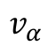
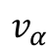
$$v_{α}$$
$$v_{α}$$

Slide 20
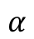
$$v_{α}$$
$$α$$

Slide 21
$$v_{α}$$
$$α$$

Slide 22
$$v_{α}$$
$$α$$

Slide 23
$$v_{α}$$
gsin(α)
$$α$$

Slide 24
y
S
τ
u
x

Slide 25
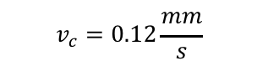
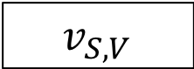
$$v_{S,V}$$
$$v_{c}=0.12\frac{mm}{s}$$

Slide 26
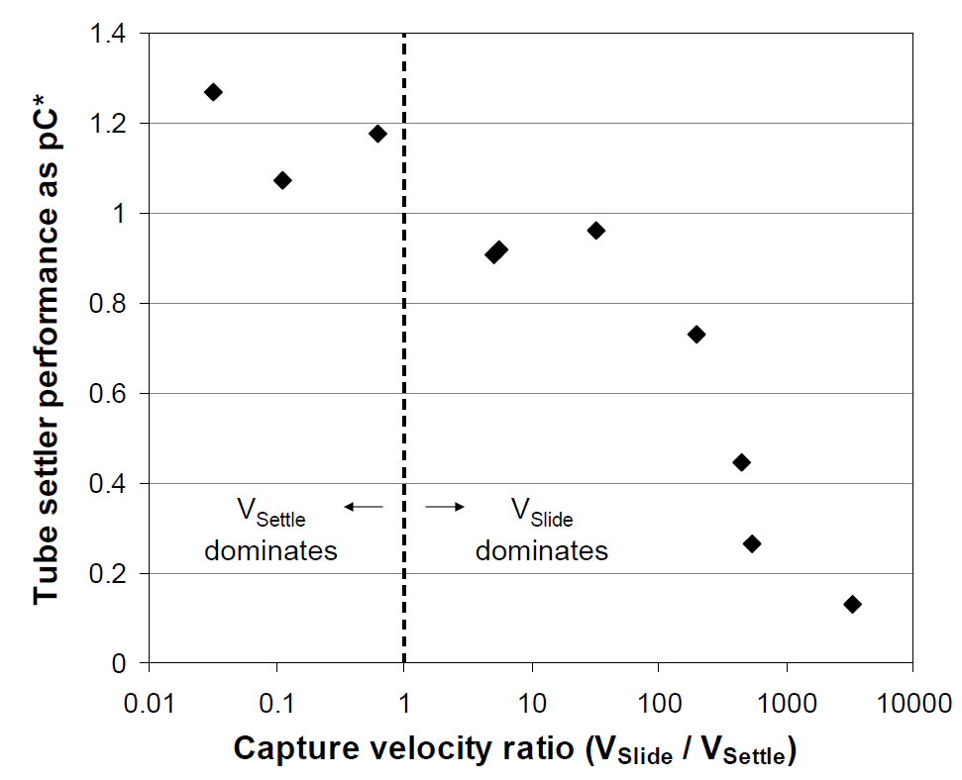
If V_{Slide} is bigger than V_{Settle}, then some flocs that we expected to capture will slide out the top
All experiments were performed at the same settle capture velocity
Floc Roll-up and its Implications for the Spacing of Inclined Settlers Matthew W. Hurst, Michael J. Adelman, Monroe L. Weber-Shirk, Tanya S. Cabrito, Cosme Somogyi, and Leonard W. Lion. Journal of Environmental Engineering, submitted (2012)

Slide 27
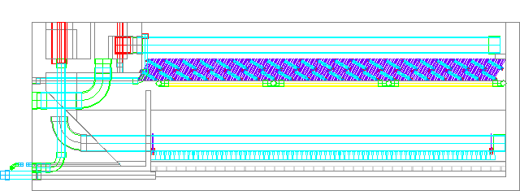
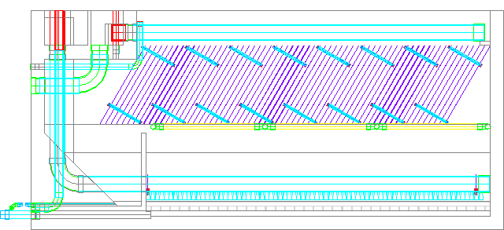
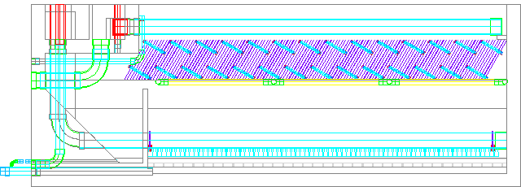
5 cm spacing = 2.27 m deep
2.5 cm spacing = 1.84 m deep
1 cm spacing = 1.64 m deep

Slide 28

P
τ
u
$∆$P

Slide 30
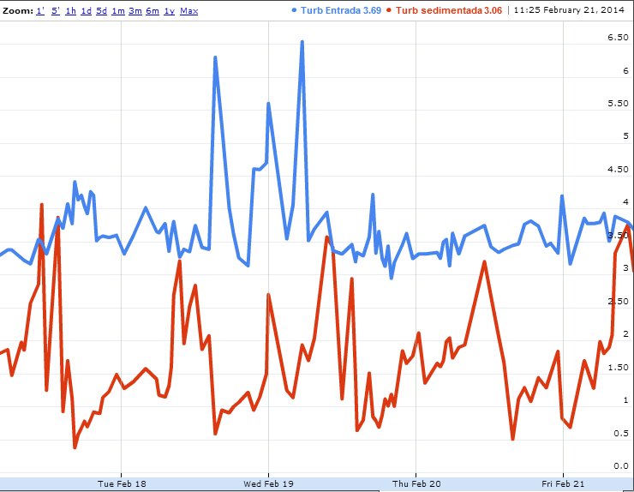
Raw water
Turbidity (NTU)
Settled water

Slide 31
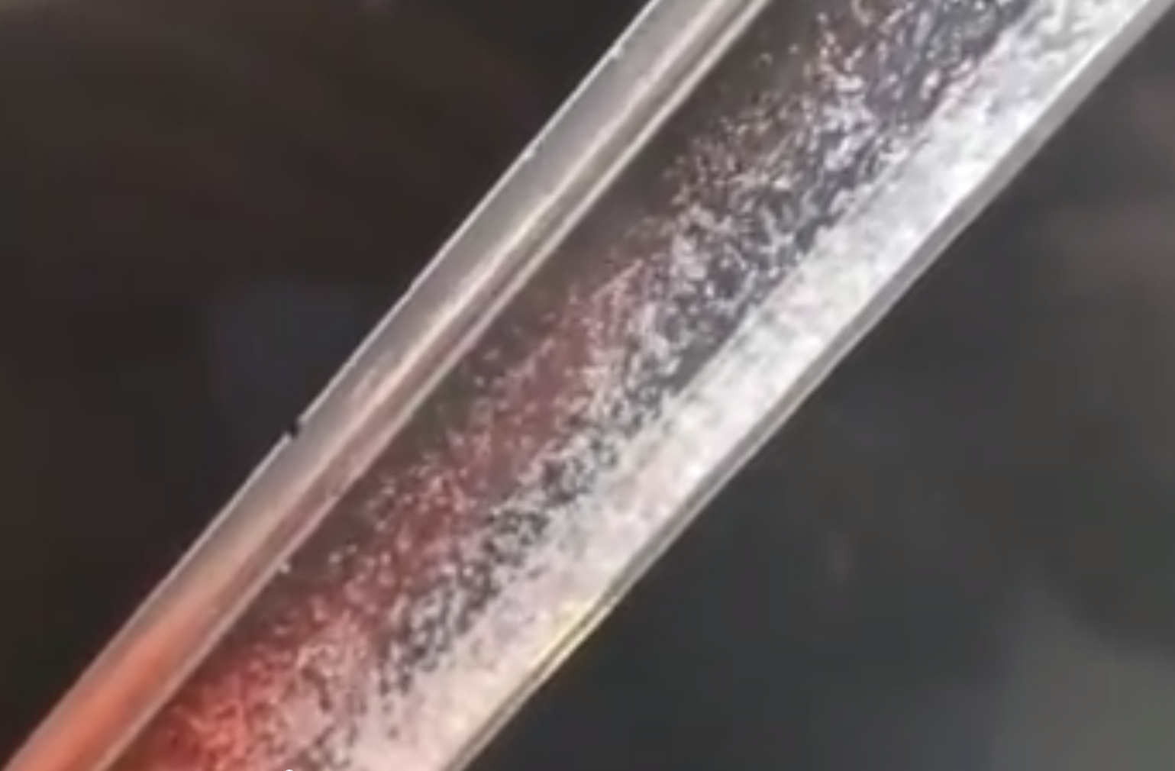

Slide 32
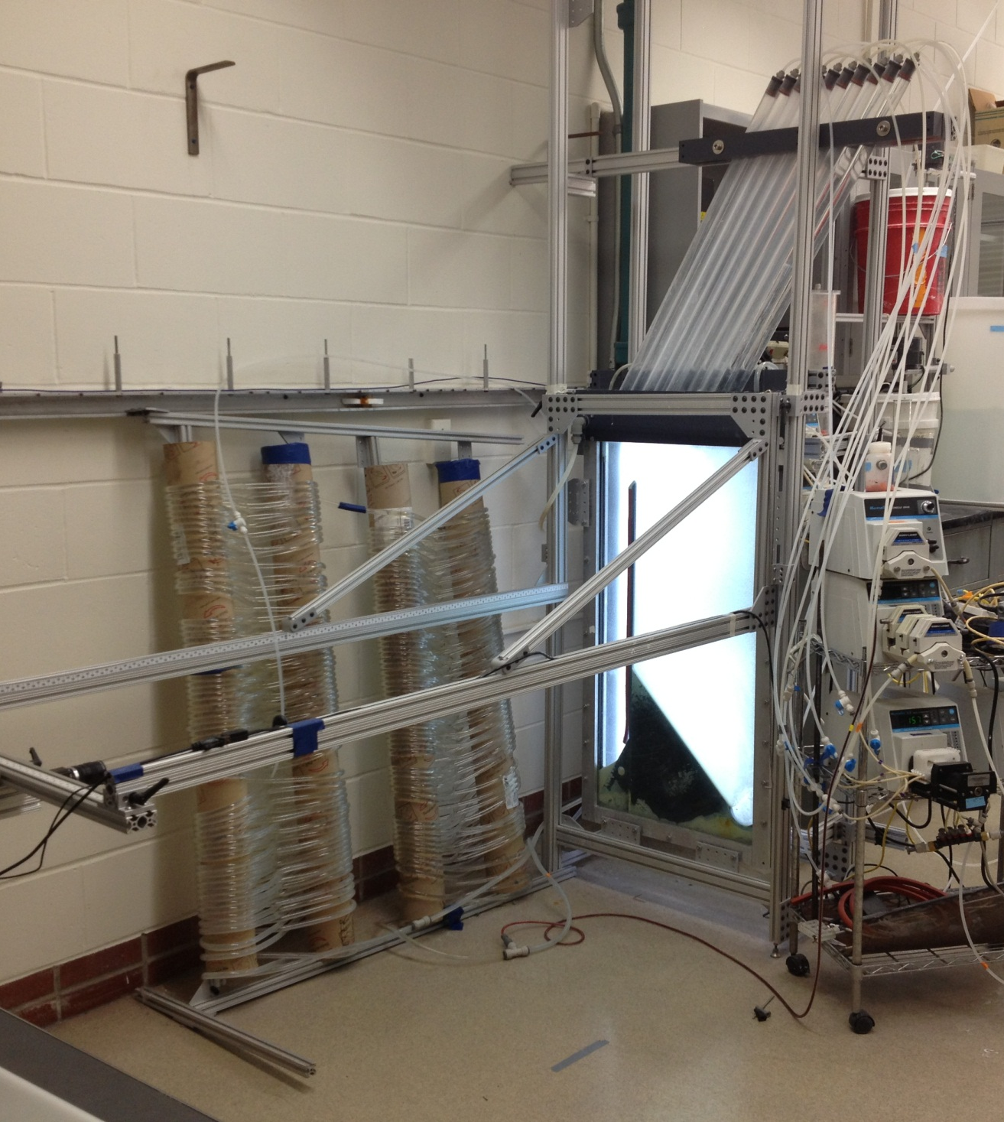
Plate Settlers
Flocculator
Sedimentation Tank

Slide 33
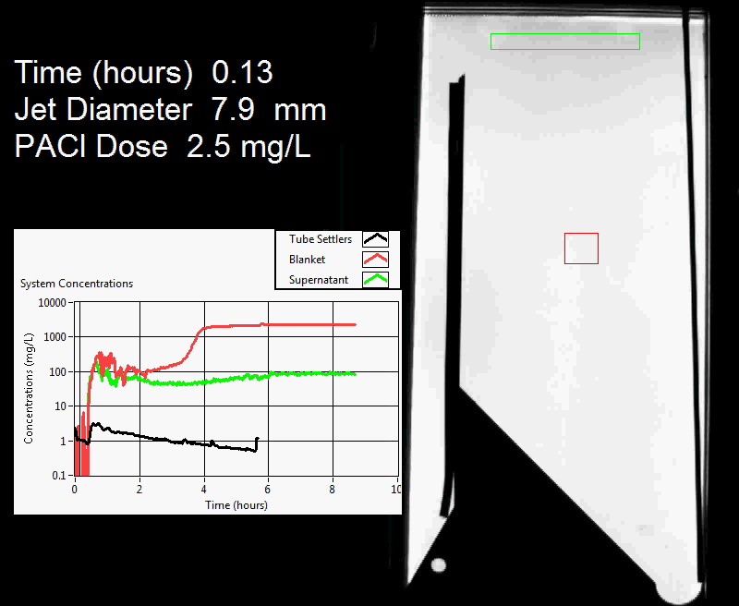

Slide 35
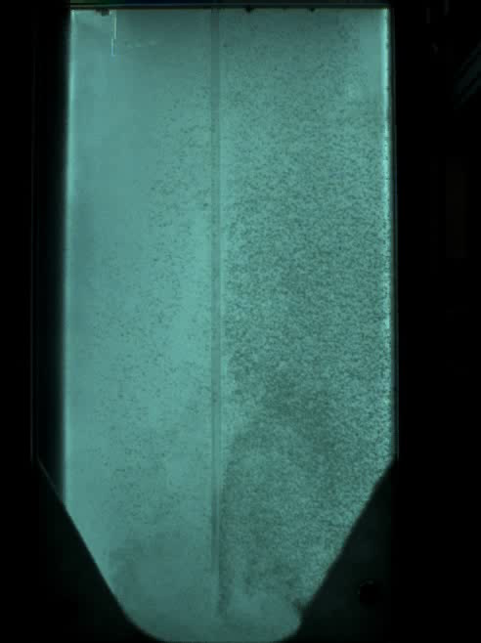
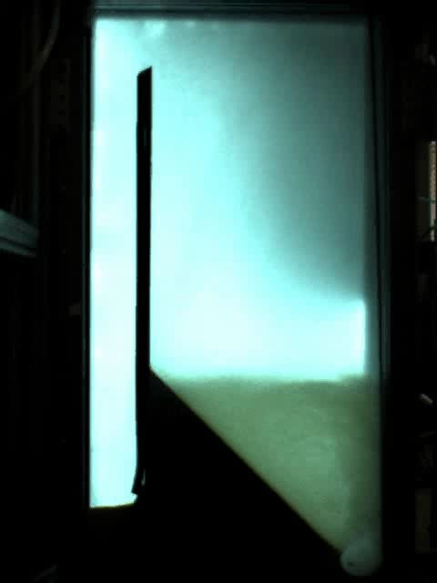
Floc Hopper
Upflow velocity is 1 mm/s
Flat bottom
Jet Reverser

Slide 36
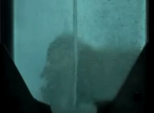
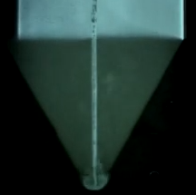
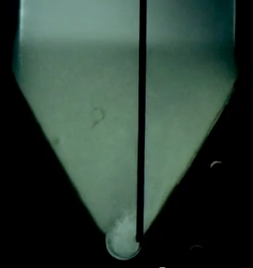
Flat bottom
Centered jet
Offset jet

Slide 37
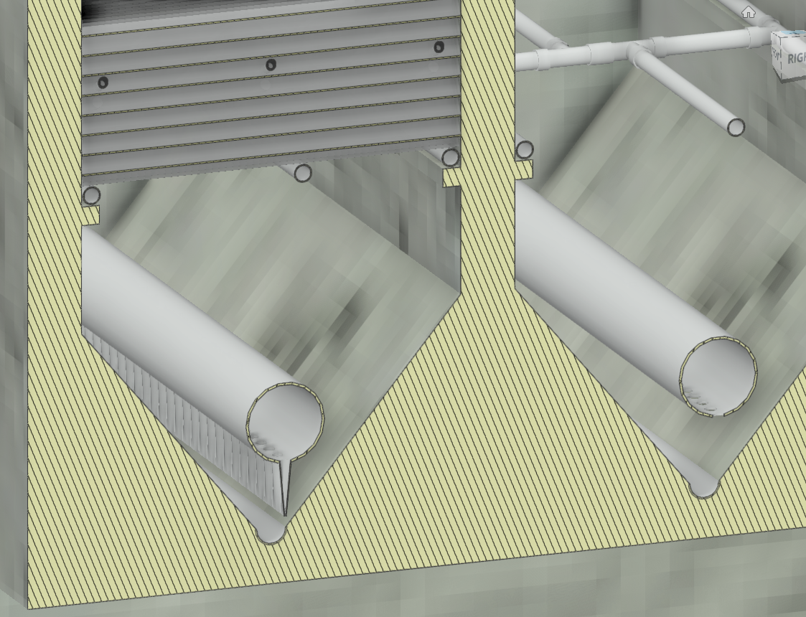
Diffusers
Floc pickup location
Jet reverser

Slide 38
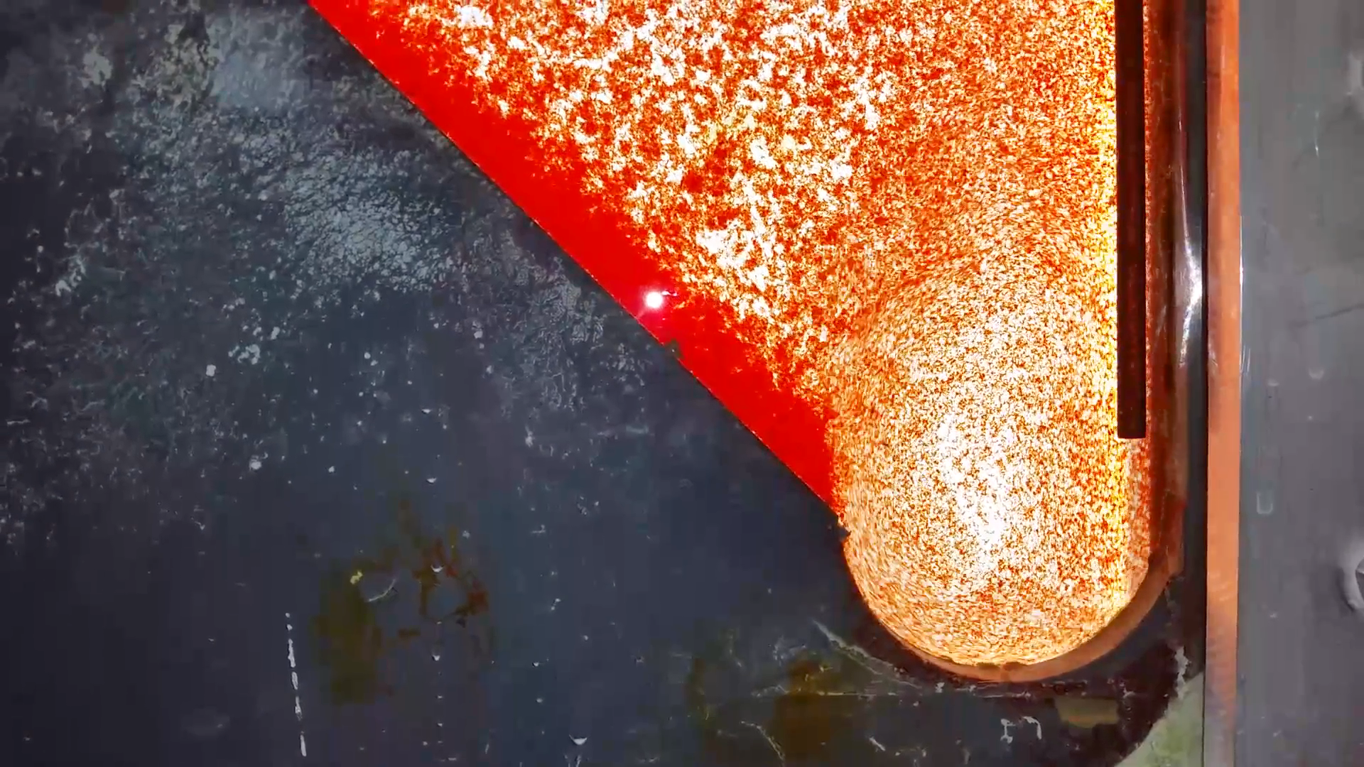
7.5 cm

Slide 39
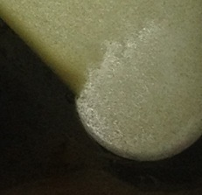
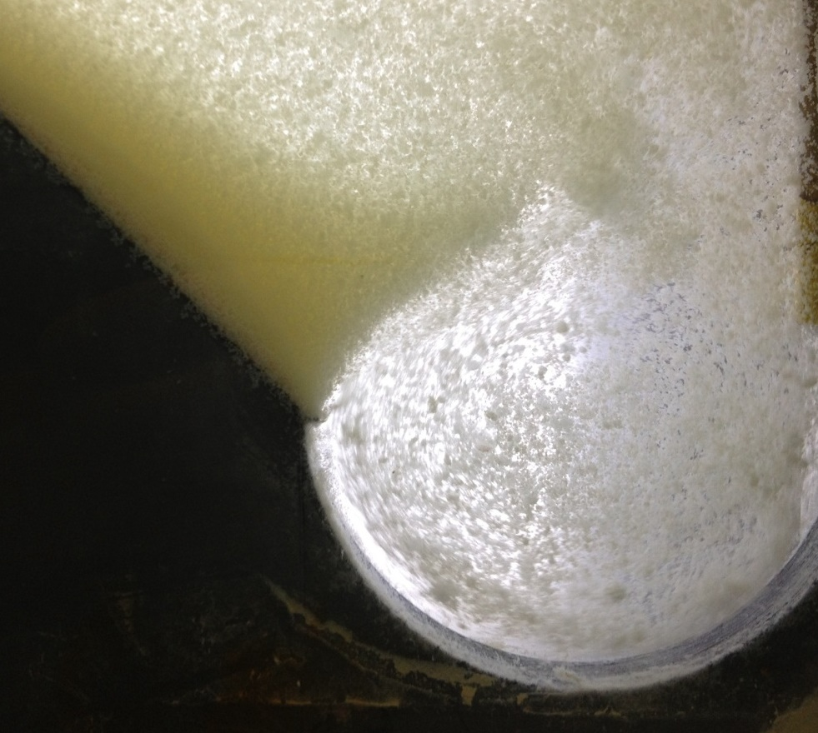
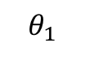
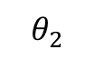
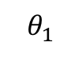
Current of settled flocs
Current of settled flocs
$$θ_{1}$$
$$θ_{2}$$
Jet
Jet
3.9 mm Jet Diameter
8.9 mm Jet Diameter
$$θ_{1}$$
<
$$θ_{2}$$

Slide 40
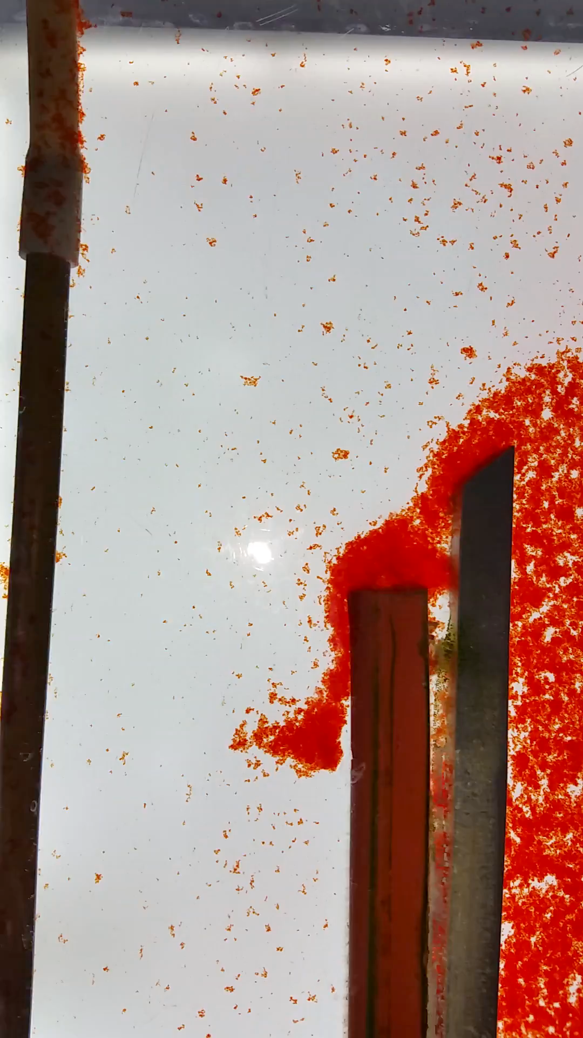
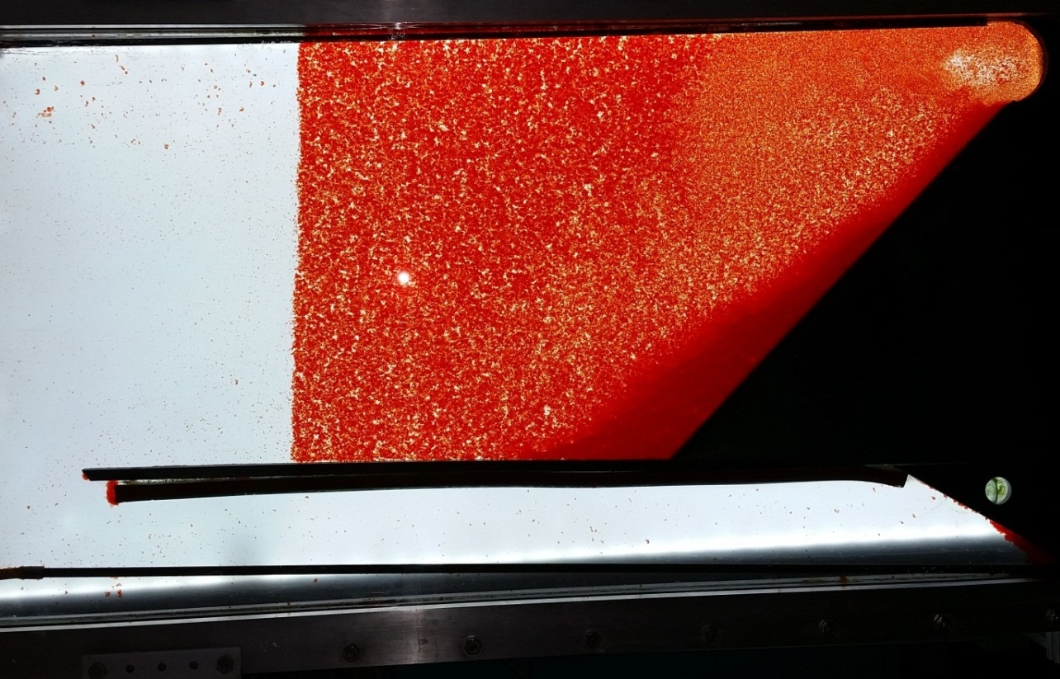

Slide 41
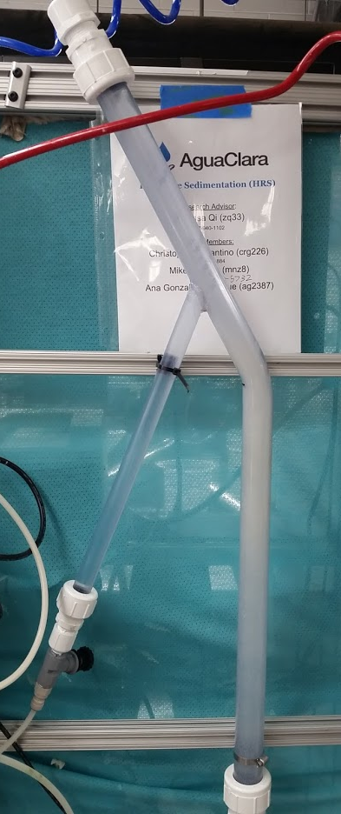

Slide 42
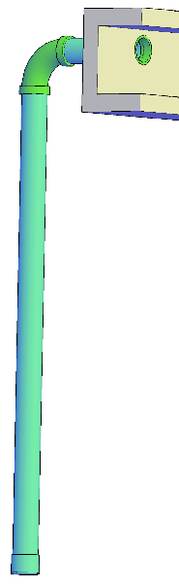
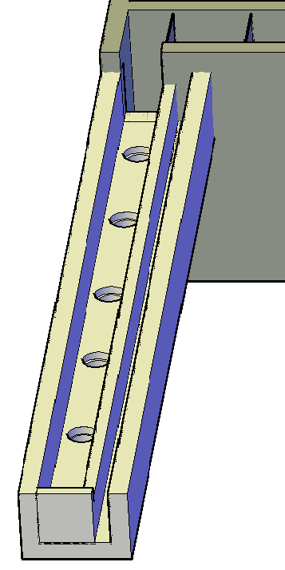
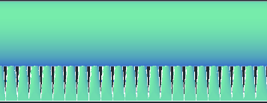

Slide 43
Inlet diffuser

Slide 44
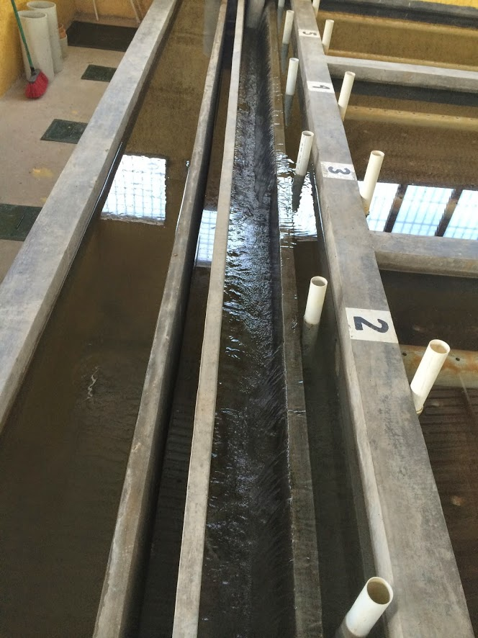
Pipe stubs to block sed tank influent manifolds
Sensor access to floc hopper
Settled water effluent channel
Weir that controls water level in sed tank (and flocculator)
Settled water effluent channel
Flocculated water to waste
Influent channel

Slide 45
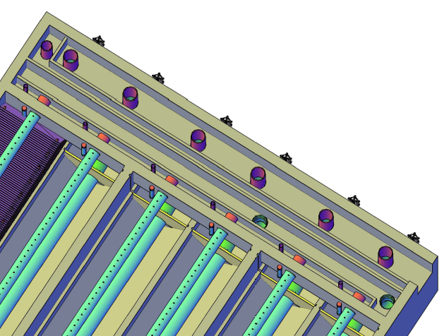
Drain for flocculated water
Weir that maintains the water level in the flocculator when flocculating to waste
Wall between inlet and outlet channels
Exit weir that maintains the water level in the sedimentation tank (and flocculator)
Exit to the filters
Entrance from the flocculator

Slide 46
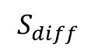
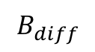
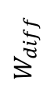
$$B_{diff}$$
$$S_{diff}$$
$$W_{diff}$$

Slide 47
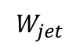
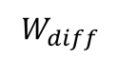

$$v_{jet}$$
$$W_{diff}$$
$$W_{jet}$$

Slide 50



Slide 51
Identify the failure modes for this geometry
1 m
Sed tank cross- section showing bottom geometry
Slot that runs the length of the sed tank
Inlet manifold/drain

Slide 52


